Slide 2
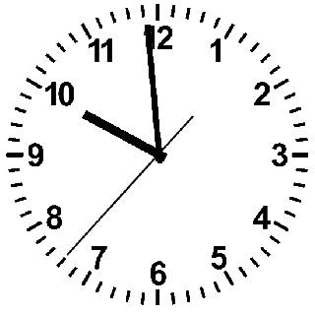
Sarcopenia
Notes:
The ticking of the clock never stops, every moment we get older, and one of the most striking effects of age is probably the involuntary loss of muscle mass, strength, and function. This is called Sarcopenia.

Slide 3
Computational approaches for the therapeutic target discovery to ame-liorate muscle wasting during aging and disease
M.Sc. Karen Guerrero Vazquez
Dr. Katarzyna Whysall
Dr. Pilib O Broin

Slide 4
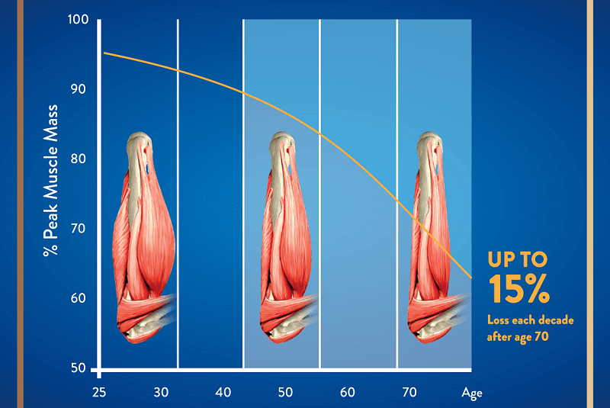
Notes:
. From the time you are born to around the time you turn 30, your muscles grow larger and stronger. But at some point in your 30s, you start to lose muscle mass and function. No matter the lifestyle, everybody is going to loss between 3 to 8% of muscle mass per decade after age 30, and this rate of decline is even higher after the age of 60. Sarcopenia is associated with detrimental clinical outcomes, such as a reduced quality of life, frailty, an increased risk of falls, fractures, hospitalization, and mortality.

Slide 5
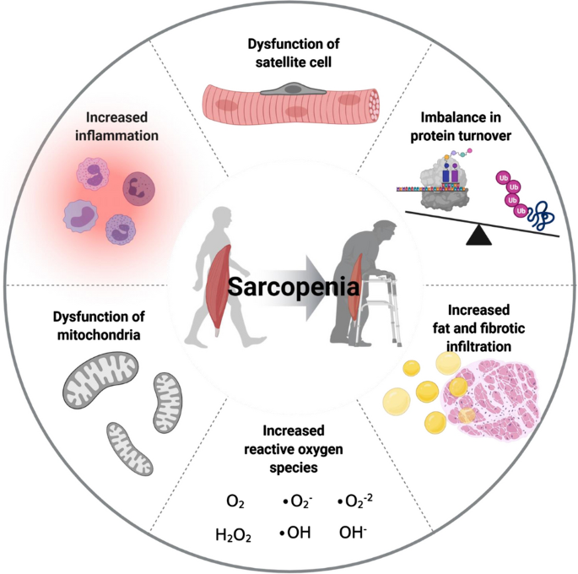
Yanai, 2020
Notes:
Several factors, including chronic inflammation, increased reactive oxidative species, increased fibrosis of muscle, and increased loss of motor neurons, have been reported to contribute to development of sarcopenia
Chronic inflammation
Increased reactive oxygen species
Increased fibrosis of muscle
Increased loss of motor neurons

Slide 6
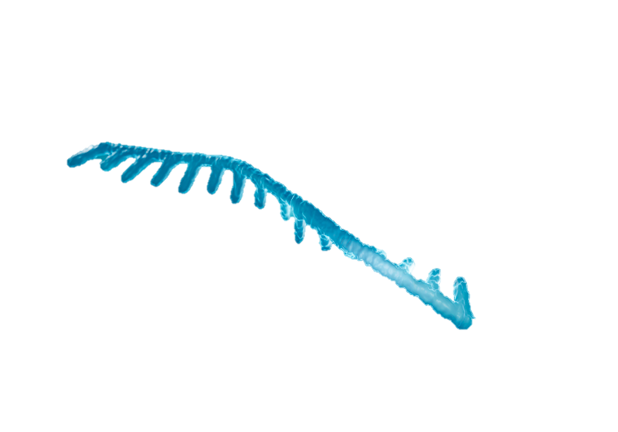
Micro-RNA

Slide 7
non-coding RNAs
regulation of gene expression
14 and 33 nucleotides
Yanai, 2020
Notes:
Mircro RNA or miRNA are conserved small non-coding RNAs that play an important role in the regulation of gene expression, they are short nucleotide single stranded RNAs (ssRNAs), between 14 and 33, with an average of 20 as MirBase suggest today.

Slide 8
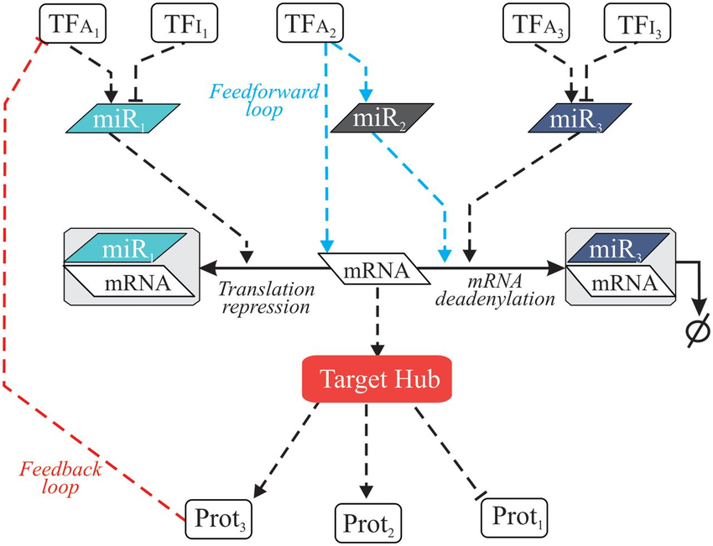
Regulatory Networks
Notes:
It is likely that miRNAs naturally build regulatory networks that control different cellular functions,

Slide 9
Regulatory Networks
Notes:
It is likely that miRNAs naturally build regulatory networks that control different cellular functions,
mathematical representation of a network and it describes the relationship between lines and points

Slide 10
There’s a computer representation of the microRNAs and their interaction that allows the identification of micro RNA for the treatment of Sarcopenia.

Slide 11
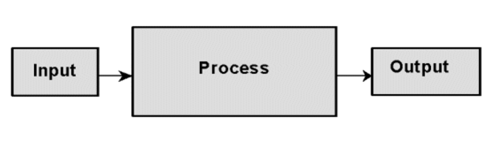
Computational model
?

Slide 12
1.- Define output
2.- Define inputs
3.- Define model

Slide 13
Objective
Localize micro RNA with potential as therapeutic for Sarcopenia
Small number (<20) miRNAs for further experimentation
Enough information to understand the working mechanism

Slide 14
Available input…
Available online repositories…
Own unpublished data on young and old
Muscle and primary cells in humans

Slide 15
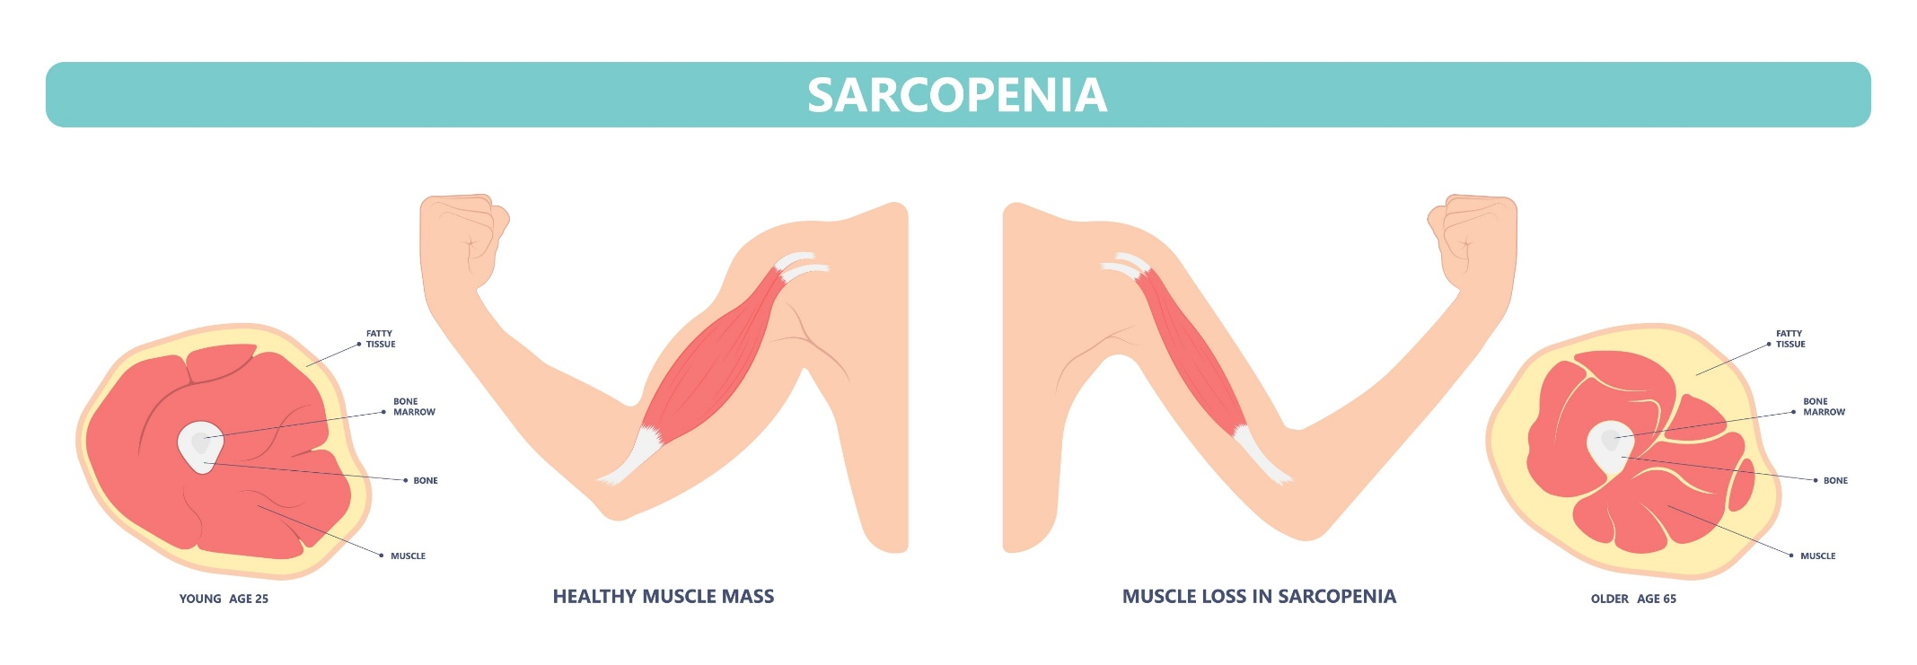
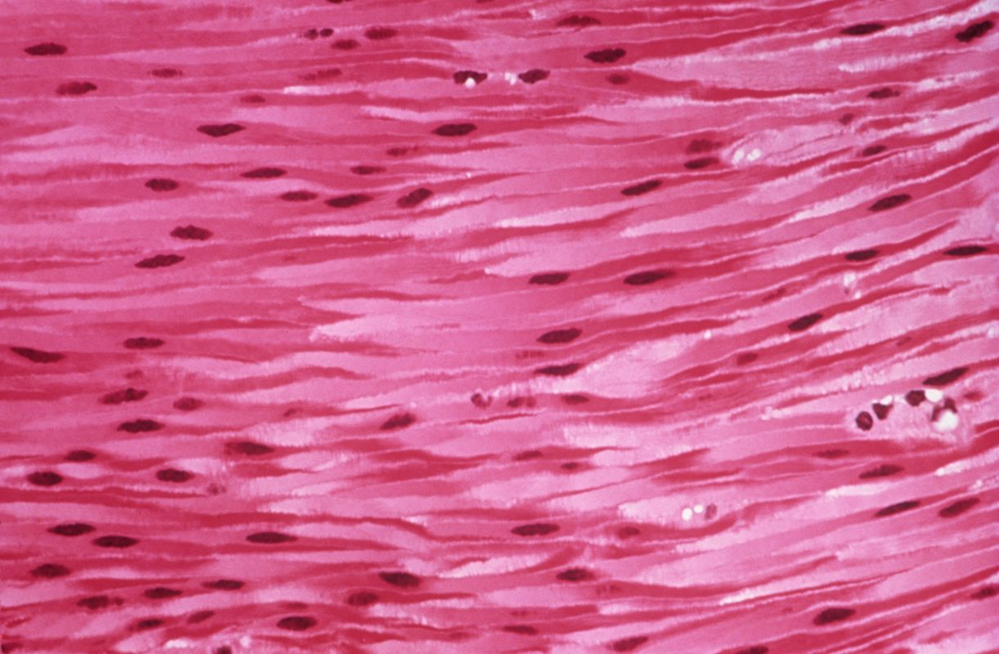
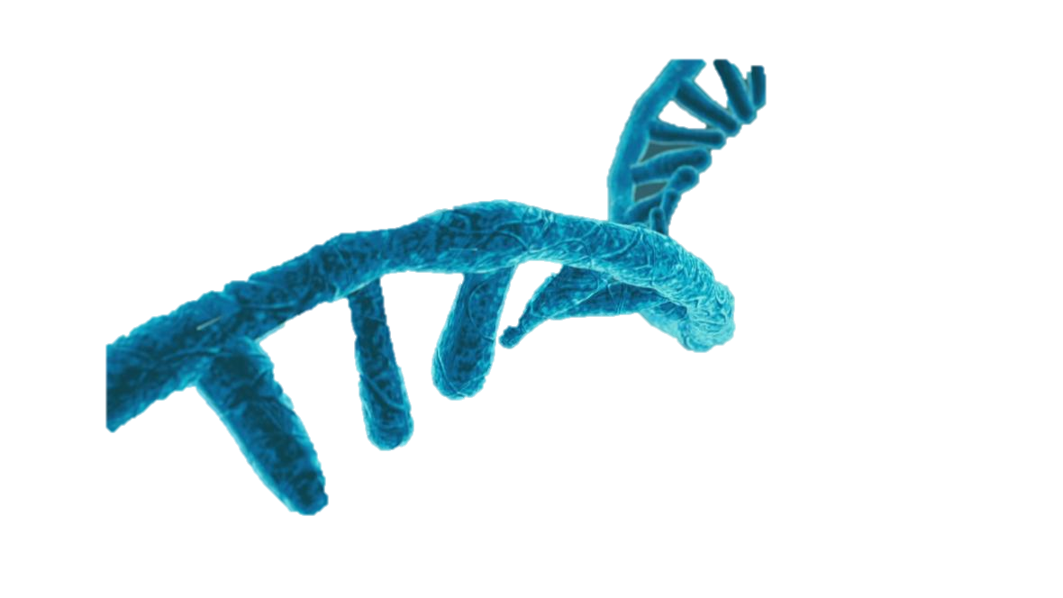
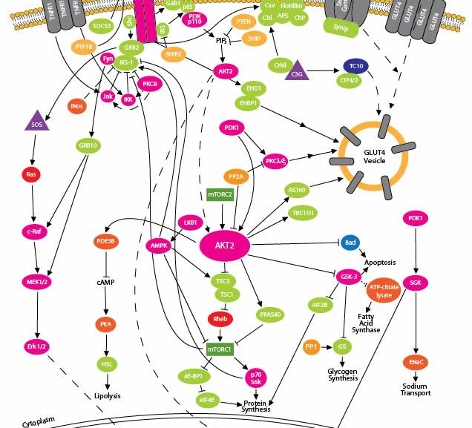

Slide 16

Notes:
We are swimming in a sea of data, the quality of the information is something that is currently under process, from the sources of the data to the value to the project. This will be tuned alongside the design of the network itself.

Slide 17
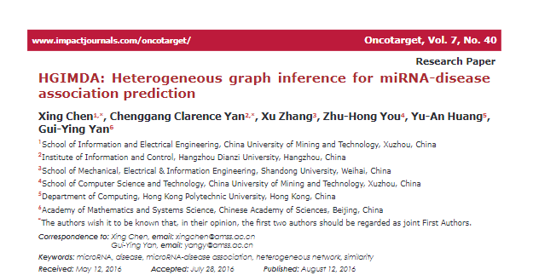
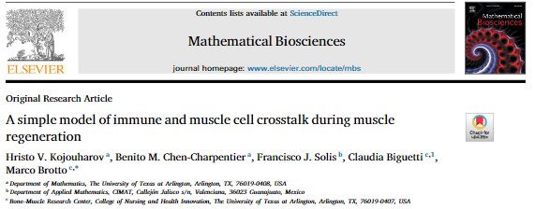
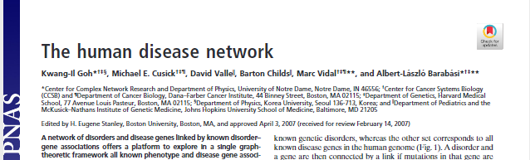
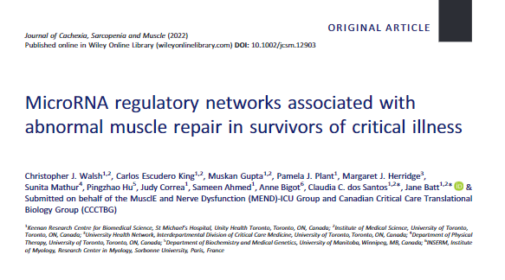
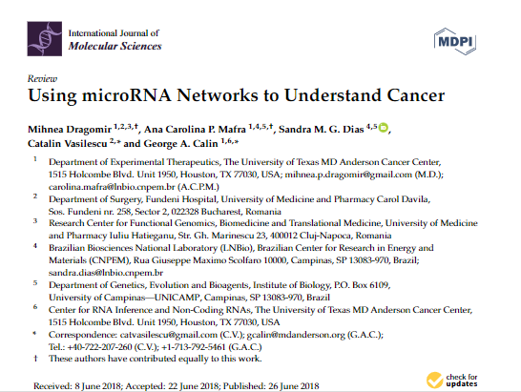
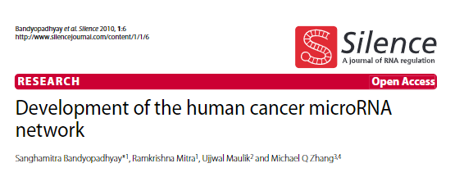
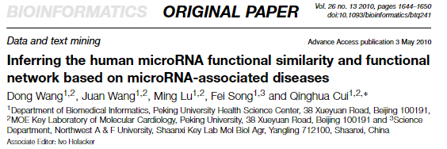
Notes:
Many works had been done in the past to find the influence of micro RNA in different diseases, appealing to different measures and rules.
Differential expression based vs unbias

Slide 18
Planned Methodology

Slide 19
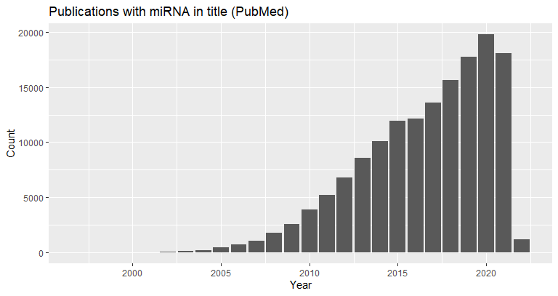


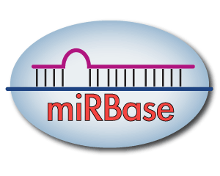
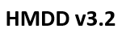



Data collection

Slide 20
Definition of the network
Rules
Relationship
Biological entity 1
Biological entity 2

Slide 21
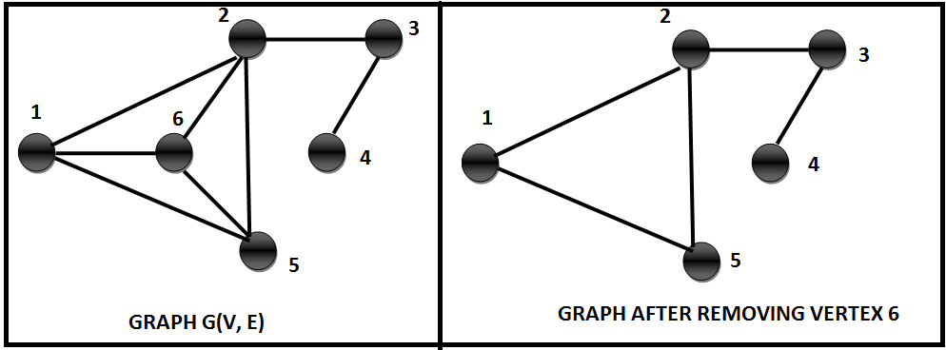

Graph operations
Similarity
Clusters
Centralities

Slide 22
Artifacts
Knowledge
Scale
Clear link
Tuning number of input nodes
High-throughput
Nonsense

Slide 23
Results

Slide 24

My own local database
+
=
24

Slide 25


Tool to standardize gene names
+
Gene names

Slide 26
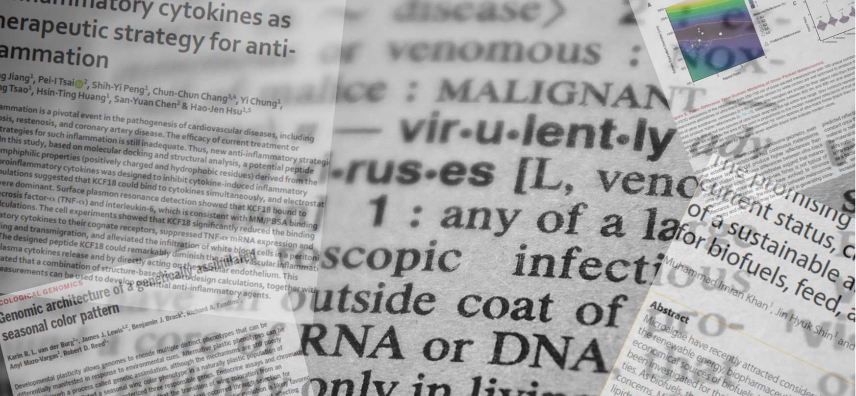

Paper miner
Quick scan of literature
Selecting the best papers
Novelty (year)
Relevance (number of citations)
App Note

Slide 27
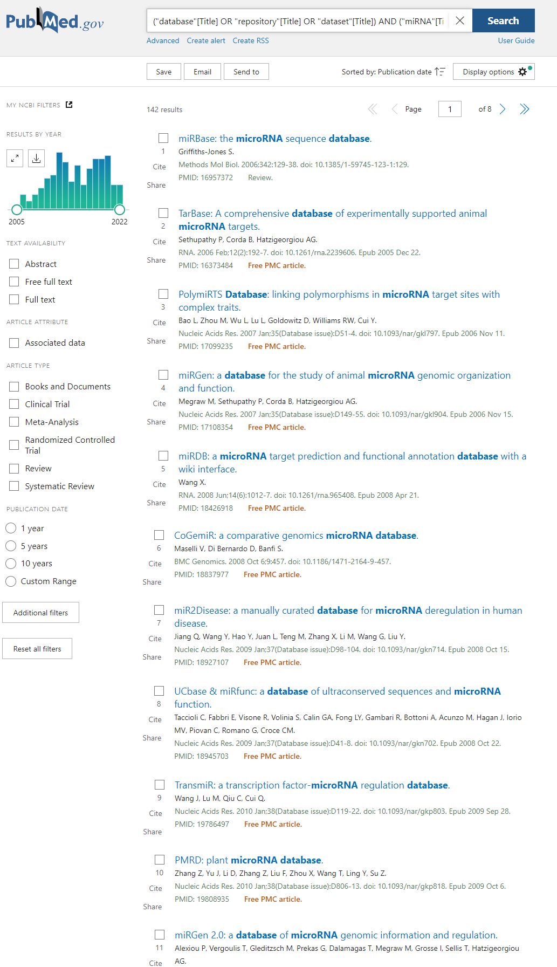
Year publication
Number of citations
Pubmed Query
List of “best” articles
Selection of the articles
("database"[Title] OR "repository"[Title] OR "dataset"[Title]) AND ("miRNA"[Title] OR "microRNA"[Title] OR "micro RNA"[Title])

Slide 28
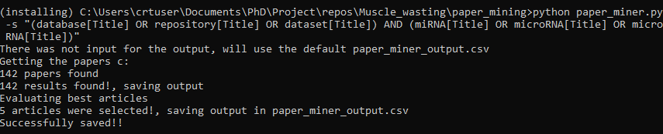
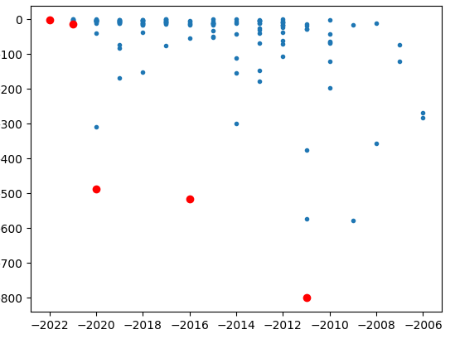
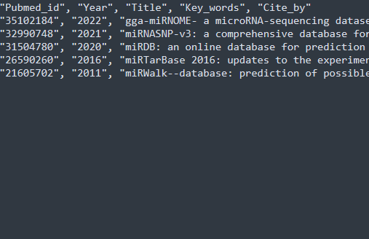

Slide 29
Immediate future work
Use Paper miner to select the literature of Networking on microRNA
Evaluate the strengths and weaknesses on a measurable way (Publication)
Design of the inputs and rules for the network
Construction of the network

Slide 30
Acknowledgements
This presentation has emanated from research conducted with the financial support of Science Foundation Ireland under Grant number [18/CRT/6214 ]

Slide 31
Multi-objective optimization
Two objectives:
Having the most recent papers
With the most citations
Dominance:
An element that is better than other in all criteria
Pareto set
Set of elements that are not dominated by anyone else

Slide 32
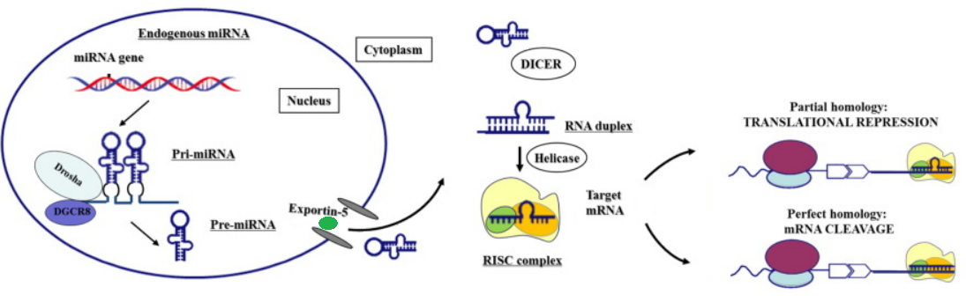
miRNA biogenesis
Notes:
Modified from https://www.thelancet.com/article/S2352-3964(16)30423-6/fulltext

Slide 33
Database | year | Cites | Organism | Website | down | avail | PubmedID | Content | information
miRBase | 2014 | 2368 | Miscellaneous | www.mirbase.org/ | Yes | Yes | 24275495 | General Information | miRNA/Target interactions
smiRNAdb | 2007 | 1817 | Miscellaneous | www.mirz.unibas.ch/cloningprofiles/ | No | No | 17604727 | Expression datasets | Expression profiles
microRNA.org | 2008 | 1270 | Miscellaneous | www.microrna.org/ | No | No | 18158296 | Predicted miRNA | Expression profiles miRNA/Target interactions Phylogeny
miRWalk | 2011 | 830 | NA | NA | NA | NA | 21605702 | Predicted miRNA | Target gene
miRBase | 2019 | 809 | Miscellaneous | www.mirbase.org | Yes | Yes | 30423142 | General Information | miRNA/Target interactions
miRTarBase | 2010 | 563 | Miscellaneous | mirtarbase.mbc.nctu.edu.tw/ | Yes | Yes | 21071411 | General Information | miRNA/Target interactions Phylogeny
miRTarBase | 2016 | 523 | Miscellaneous | mirtarbase.mbc.nctu.edu.tw | Yes | Yes | 26590260 | General Information | miRNA/Target interactions Phylogeny
HMDD | 2015 | 389 | Homo sapiens | 202.38.126.151/hmdd/mirna/md/ | No | No | 18923704 | Association to diseases | Disease
miRDB | 2020 | 374 | NA | NA | NA | NA | 31504780 | Expression datasets | Target gene
mirDIP | 2017 | 111 | Miscellaneous | ophid.utoronto.ca/mirDIP/ | Yes | Yes | 21364759 |  | miRNA/Target interactions
Rfam | 2021 | 49 | NA | NA | NA | NA | 33211869 |  | NA
miRNASNP | 2021 | 13 | NA | NA | NA | NA | 32990748 | Single nuclotide | Expression profiles miRNA/Target interactions SNPs
mirtronDB | 2019 | 5 | Plants | mirtrondb.cp.utfpr.edu.br/ | Yes | Yes | 30874795 |  | NA
CSCD2 | 2022 | 3 | NA | NA | NA | NA | 34551437 |  | NA
DIANAmiTED | 2022 | 0 | NA | NA | NA | NA | 34469540 |  | NA

Slide 34
Download data
Database | year | Cites | PubmedID | Content | Prediction Algorithm | API | API alternative
miRBase | 2014 | 2368 | 24275495 | General | NA | NA | NA
miRWalk | 2011 | 830 | 21605702 | Predicted miRNA | Yes | NA | NA
miRTarBase | 2010 | 563 | 21071411 | General | NA | NA | NA
miRDB | 2020 | 374 | 31504780 | Expression | Yes | NO | Yes
DIANAmiTED | 2022 | 0 | 34469540 | Expression | NA | NA | NA

Slide 35
Mature mirna
Mirna_id Precursor Start End
Mirna
Id Name Sequence Species_id
Species
Id Organism Name Genomic assembly

Slide 36
Integration
Mature mirna
Mirna_id Precursor Start End
Target
Mature mirna Target gene Source Probability
Genes
Gene Disease
Mirna
Id Name Sequence Species_id

Slide 37
Queries
Select count( distinct (mirna_mature)) ,
count ( distinct (mrna) ),'sarcopenia‘
from binding
where mirna_mature like "hsa-%"
and mrna in (select gene
from gene_bank
where gene_bank.condition=' Sarcopenia')

Slide 38
Graph
Pictorial representation or a diagram that represents data or values in an organized manner.
Nodes
Edges

Slide 39
Graph
Pictorial representation or a diagram that represents data or values in an organized manner.
Nodes
Edges
miR-23a
MYOG
Inhibits
Associated
Sarco-penia

Slide 40
What – How – For what

Slide 41
Queries
( ('Micro RNA'[Title])
OR (MicroRNA[Title]) OR (Mirna[Title]) OR (Disease[Title])
OR (Muscle[Title]) OR (Sarcopenia[Title]) )
AND ( (Computer[Title])
OR (Graph[Title]) OR (Model[Title]) OR (Network[Title])
OR (Networking[Title]) OR (Bioinformatic[Title]) OR (Simulation[Title]) )
AND ( (Association[Title])
OR (Development[Title])
OR (Discovery[Title]) OR (Prediction[Title]) OR (Functional[Title])
OR (Identification[Title]) OR (Inference[Title]) OR (Regulatory [Title])
OR (Signature[Title]) )

Slide 42
PubMed ID | Year | Title | Cites
32117922 | 2020 | A Computational Study of Potential miRNA-Disease Association Inference Based on Ensemble Learning and Kernel Ridge Regression. | 8
30186308 | 2018 | A Novel Computational Method for the Identification of Potential miRNA-Disease Association Based on Symmetric Non-negative Matrix Factorization and Kronecker Regularized Least Square. | 15
28339468 | 2017 | PBMDA: A novel and effective path-based computational model for miRNA-disease association prediction. | 139
31369383 | 2021 | A Fast Linear Neighborhood Similarity-Based Network Link Inference Method to Predict MicroRNA-Disease Associations. | 33
32484539 | 2020 | miRNet 2.0: network-based visual analytics for miRNA functional analysis and systems biology. | 87
31684860 | 2019 | MIENTURNET: an interactive web tool for microRNA-target enrichment and network-based analysis. | 45
30142158 | 2018 | MDHGI: Matrix Decomposition and Heterogeneous Graph Inference for miRNA-disease association prediction. | 112
29701758 | 2018 | BNPMDA: Bipartite Network Projection for MiRNA-Disease Association prediction. | 110
27795564 | 2016 | A network-biology perspective of microRNA function and dysfunction in cancer. | 270

Slide 43
Already reviewed literature
Authors | Year | Title | Cites
Xing Chen, [...], and Gui-Ying Yan | 2016 | HGIMDA: Heterogeneous graph inference for miRNA-disease association prediction. | 107
Sanghamitra Bandyopadhyay, [...], and Michael Q Zhang | 2010 | Development of the human cancer microRNA network | 100
Dong Wang, […], Qinghua Cui | 2010 | Inferring the human microRNA functional similarity and functional network based on microRNA-associated diseases | 234
Xing Chen, […], Li Huang2 | 2018 | MDHGI: Matrix Decomposition and Heterogeneous Graph Inference for miRNA-disease association prediction. | 114

Slide 44
Current approaches
Interaction miRNA-Disease
HMDD
Semantics
MeSH

Slide 45
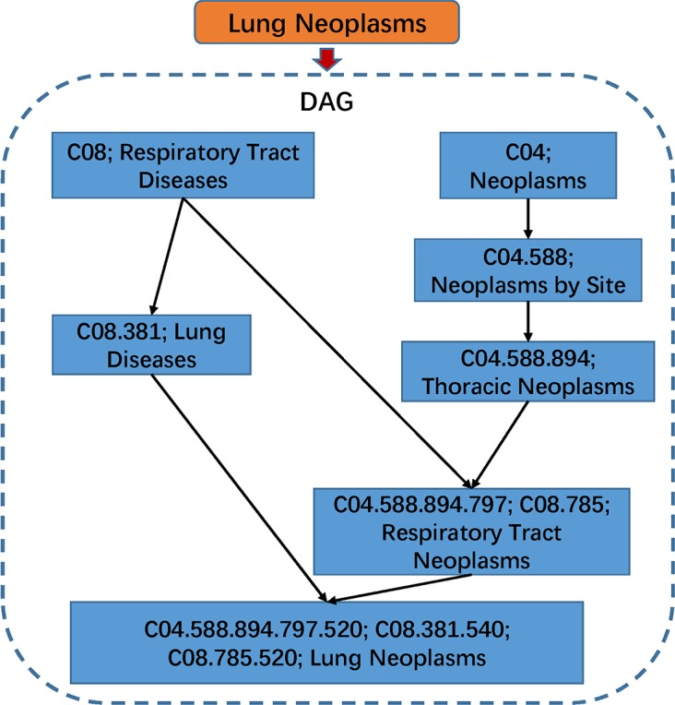

Slide 46
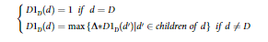
In DAG(D),the contribution of disease d to the semantic value of disease D was defined as:

Slide 47
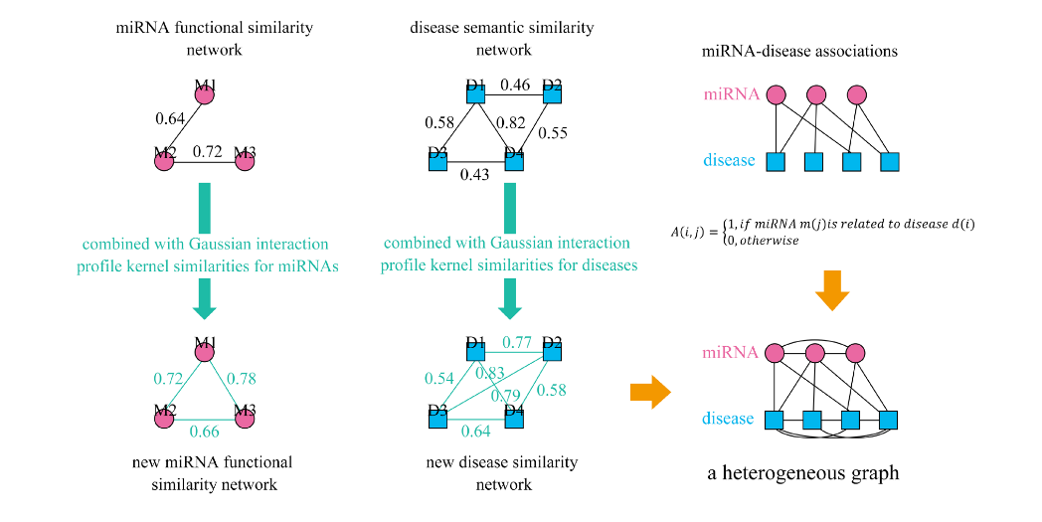

Slide 48
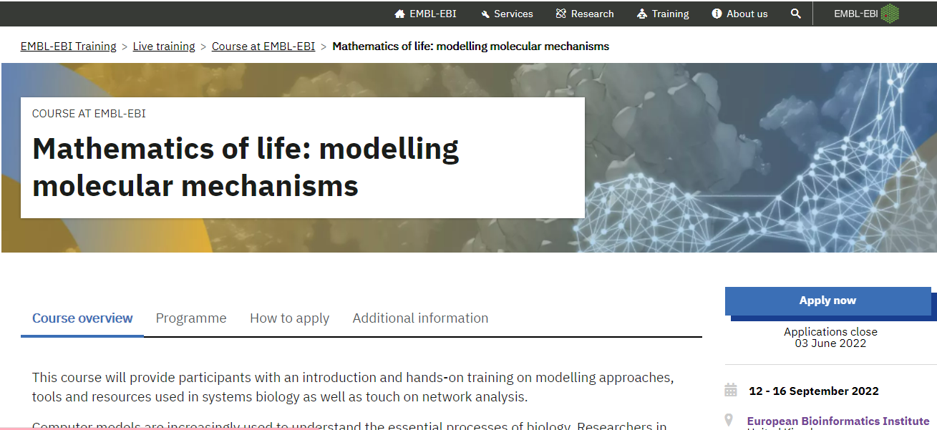

Slide 49
How to select the data?
New
Relevant
Multiple Objective Optimization
PUBMD
Notes:
miRNA are defined as 18 to 25 nucleotide single stranded RNAs (ssRNAs), which are produced from hairpin shaped precursors. They are conserved small non-coding RNAs that play an important role in the regulation of gene expression and participate in a variety of biological processes miRNAs have been found to regulate almost all cellular functions including cell proliferation, growth, differentiation and apoptosis, And as we mention, have been implicated in controlling the fate and behavior of stem cells

Slide 50
How to select the data?
PUBMED
("database"[Title] OR "repository"[Title]
OR "dataset"[Title])
AND
("miRNA"[Title] OR "microRNA"[Title]
OR "micro RNA"[Title])
Notes:
miRNA are defined as 18 to 25 nucleotide single stranded RNAs (ssRNAs), which are produced from hairpin shaped precursors. They are conserved small non-coding RNAs that play an important role in the regulation of gene expression and participate in a variety of biological processes miRNAs have been found to regulate almost all cellular functions including cell proliferation, growth, differentiation and apoptosis, And as we mention, have been implicated in controlling the fate and behavior of stem cells

Slide 51
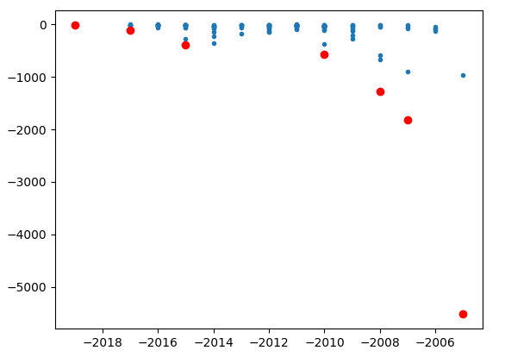
How to select the data?
Notes:
miRNA are defined as 18 to 25 nucleotide single stranded RNAs (ssRNAs), which are produced from hairpin shaped precursors. They are conserved small non-coding RNAs that play an important role in the regulation of gene expression and participate in a variety of biological processes miRNAs have been found to regulate almost all cellular functions including cell proliferation, growth, differentiation and apoptosis, And as we mention, have been implicated in controlling the fate and behavior of stem cells

Slide 53

miRNAs
Notes:
And we can implement the concept of distance and interconnection in order to interpret the impact of an miRNA.

Slide 54
Tissues
Notes:
And we can implement the concept of distance and interconnection in order to interpret the impact of an miRNA.

Slide 55
Conditions
Notes:
And we can implement the concept of distance and interconnection in order to interpret the impact of an miRNA.

Slide 56
Notes:
And we can implement the concept of distance and interconnection in order to interpret the impact of an miRNA.

Slide 57
Similarity
Cliks
Notes:
And we can implement the concept of distance and interconnection in order to interpret the impact of an miRNA.

Slide 58
3
2
Distance
1
Notes:
And we can implement the concept of distance and interconnection in order to interpret the impact of an miRNA.

Slide 60
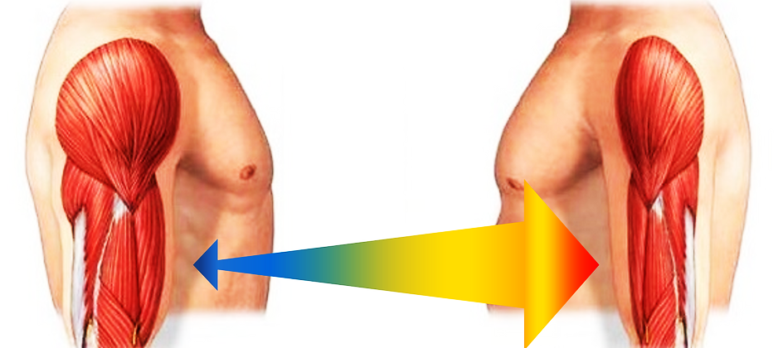
Notes:
One of the most striking effects of age is the involuntary loss of muscle mass, strength, and function, termed sarcopenia.

Slide 61
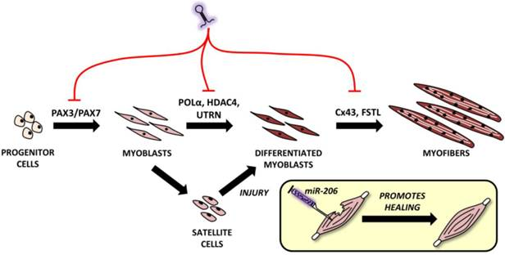
myomirs
Notes:
Muscles express their own set of muscle-enriched mirnas known as myomirs: mir1, 206, 208, 133, 486, 499.

Slide 62
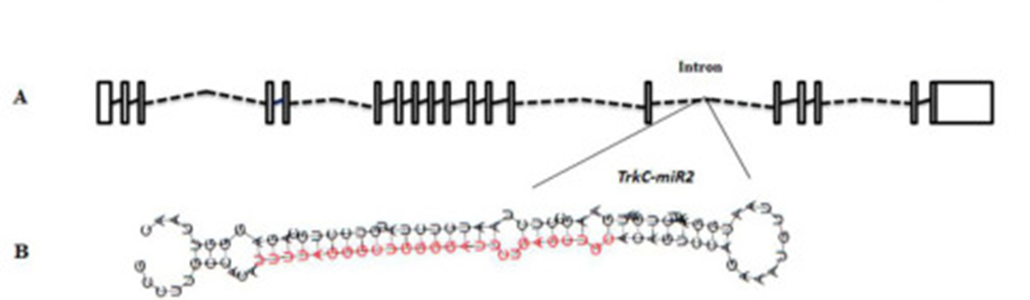
What is a miRNA
18-25 nt single stranded
conserved small non-coding RNAs
regulate almost all cellular functions
cell proliferation
Growth
differentiation
fate and behaviour of stem cells
Notes:
miRNA are defined as 18 to 25 nucleotide single stranded RNAs (ssRNAs), which are produced from hairpin shaped precursors. They are conserved small non-coding RNAs that play an important role in the regulation of gene expression and participate in a variety of biological processes miRNAs have been found to regulate almost all cellular functions including cell proliferation, growth, differentiation and apoptosis, And as we mention, have been implicated in controlling the fate and behavior of stem cells

Slide 63
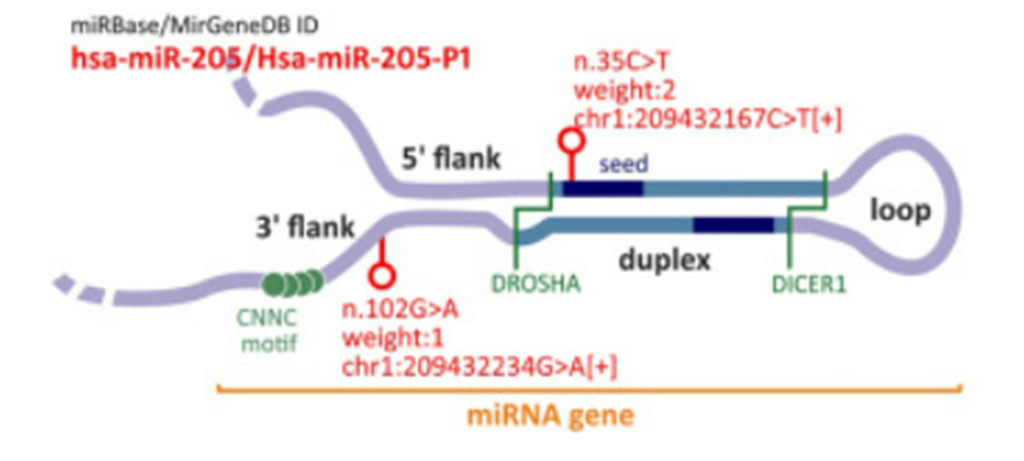
Notes:
https://www.sciencedirect.com/science/article/pii/S2666166721007292

Slide 64
Evolution of miRNA study
miRNAs fall into the class of RNAibased therapeutics
1,120,000 Academic Google
134,677 in PubMed

Slide 65
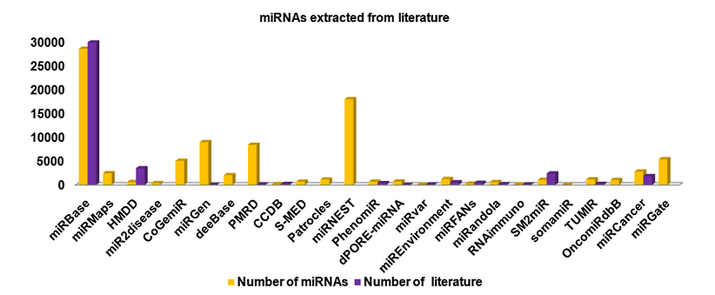
Number of miRNA in some DB

Slide 66
Garbage in, garbage out (GIGO)
Garbage data
Most amazing Data Science project ever
Garbage results

